Slide 1


SOCIAL INTERNSHIP PRESENTATION INDIAN ASSOCIATION FOR BLIND
HARINI S (C3S48855)
SNEHA I (C3S48861)
HARINI P (C3S48854)

Slide 2
INTRODUCTION
OVERVIEW OF THE INTERNSHIP ORGANIZATION AND ITS MISSION
During, internship at Indian blind association for blind, Madurai, we had the opportunity to contribute their mission of enhancing the lives of visually impaired individuals through education and community support

Slide 3

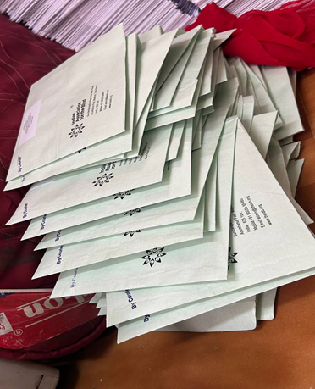
OBJECTIVES
To develop the practical skills in data collection, organization, and administrative tasks.
To support the organization in efficiently managing postal operations and updating social media event details.
To gain hands on experience in non-profit administration and contribute to meaningful projects that directly impact the community

Slide 4
ORGANIZATION BACKGROUND
Founded in 1985, the Indian Association for Blind, Madurai, is committed to empowering visually- impaired individuals through education, vocational training, and advocacy for accessibility
Includes educational support programs, vocational training initiatives, advocacy efforts for accessibility rights, and community integration project

Slide 5
ROLE AND RESPONSIBILITY
As an intern, my role involved handling administration tasks crucial to daily operation
Managing postal operations by processing and organizing school addresses for effective communication
Updating and maintaining event details on social media platform to enhance community engagement

Slide 6
KEY PROJECTS AND ACTIVITIES
Managed the processing of 1000 postal items, ensuring accurate and timely delivery to various schools
Organized and updated event details on Facebook and Google sheets, improving communication and outreach effectiveness

Slide 7
CHALLENGES FACED
Managing large volumes of postal items and ensuring precision in address labeling
Handling sensitive student information and maintaining confidentiality during data entry tasks

Slide 8
SKILLS DEVELOPED
Developed proficiency in data organization and management using Google sheet
Enhanced attention to detail and organizational skills through handling complex administrative tasks

Slide 9
IMPACT AND OUTCOMES
Improved efficiency in postal operations resulted in timely delivery and Enhanced communication
Enhanced social media presence and engagement through accurate event management and updates

Slide 10
CONCLUSION AND REFLECTIONS
My internship at the Indian Association for Blind, Madurai, provided invaluable insights into non-profit operations and community-focused initiatives
Gained a deeper appreciation for the challenges faced by visually impaired individuals and the importance of accessible education and support services
This experience has inspired me to pursue a career in non-profit management, focusing on initiative that promote inclusitivity and empower marginalized communities

Slide 11
THANK YOU

